Slide 1
E-Commerce Dynamic Pricing and Elasticity Analytics
Presented by: Shailaja Tallapally
Internship Project: Data Analytics/AI
Tools Used: Python, SQL, Power BI, Excel
Date:07 Aug 2026

Slide 2
Project Overview
Project Objective
Analyze product pricing and discount trends in an e-commerce dataset.
Study the impact of discounts, sale events, and stock status on pricing.
Build an interactive Power BI dashboard for data visualization.
Generate insights to support pricing and business decisions.
Technologies Used
Python – Data cleaning and exploratory data analysis (EDA)
SQL – Data querying and analysis
Power BI – Dashboard creation and visualization
Excel – Data preparation and validation
Expected Outcome
Understand pricing patterns across product categories.
Identify the effect of discounts and sale events.
Provide interactive dashboards for decision-making.
Recommend strategies for better pricing and inventory management.

Slide 3
Problem Statement
Business Challenges
Frequent changes in product prices make pricing decisions difficult.
Discounts and promotional events influence customer purchasing behavior.
Product categories respond differently to pricing strategies.
Businesses need data-driven insights to optimize pricing and maximize revenue.
Project Goal
This project analyzes pricing trends, discounts, sale events, stock status, and customer ratings using Python, SQL, and Power BI to support effective pricing decisions through interactive dashboards.
Product data→ Data Analysis→ Price Insights→ Dashboard→ Business Decisions

Slide 4
Dataset Description
Dataset Name: Apple Products Pricing (2020–2026)
Total Records: ~80,000
Total Columns: 14
File Format: CSV
Key Features
Date & Platform
Product Category & Model Name & Condition
Launch Price (USD/INR)
Current Price (USD/INR)
Discount Percentage
Sale Event
Stock Status
Customer Rating & Reviews
Purpose: Analyze product pricing, discounts, stock status, and customer ratings to generate business insights and support dynamic pricing decisions.

Slide 5
Data Cleaning
Data Cleaning Steps
Removed duplicate records.
Checked and handled missing values.
Converted the Date column to the correct data type.
Verified and corrected numeric data types for pricing columns.
Standardized column names and formatting.
Identified outliers using statistical methods.
Prepared a clean dataset for analysis and dashboard development.
Outcome
Improved data quality and consistency.
Reduced errors before analysis.
Created a reliable dataset for SQL queries and Power BI visualizations.

Slide 6
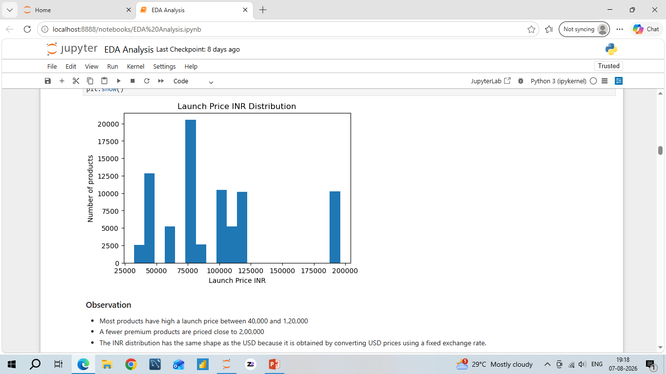
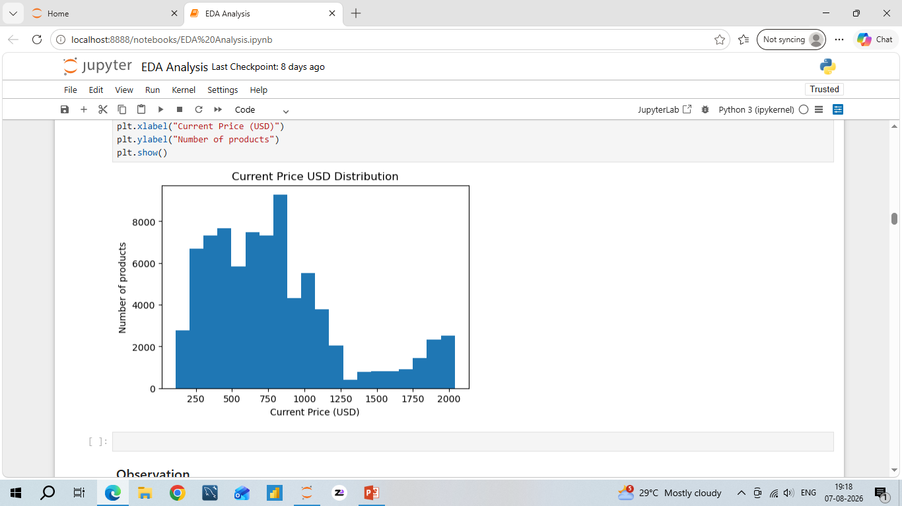
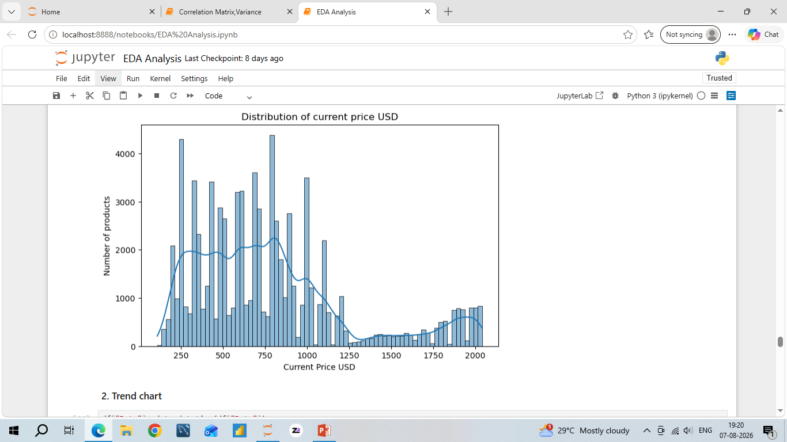
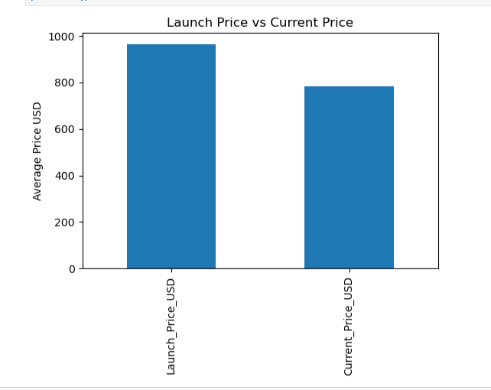
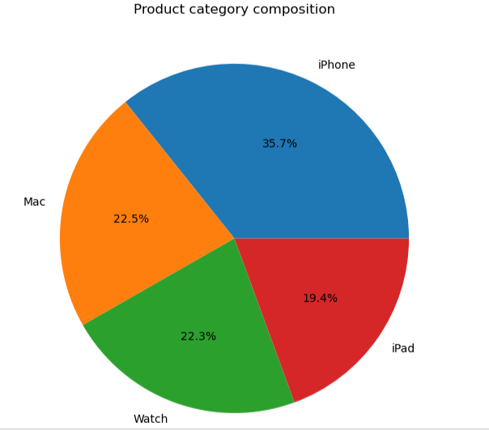
Exploratory Data Analysis(EDA)

Slide 7
SQL Queries
SQL Techniques Used
Data Import & Table Creation
Aggregate Functions
GROUP BY & ORDER BY
Joins & Views
Ranking & Window Functions
Running Total Analysis
Functions Used COUNT() | SUM() | AVG() | MIN() | MAX()
ROW_NUMBER() | RANK() | DENSE_RANK() | LAG() | LEAD()
SQL Outcome
SQL analysis transformed raw pricing data into structured insights for further EDA and Power BI dashboard development.

Slide 8
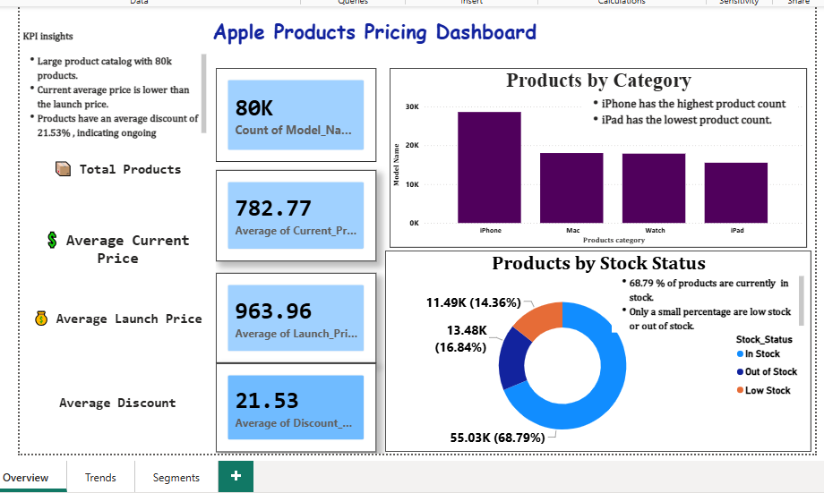
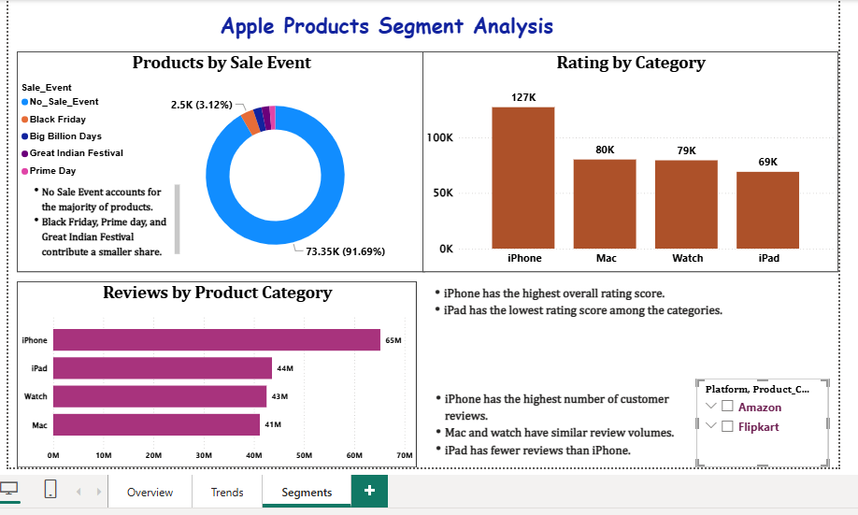
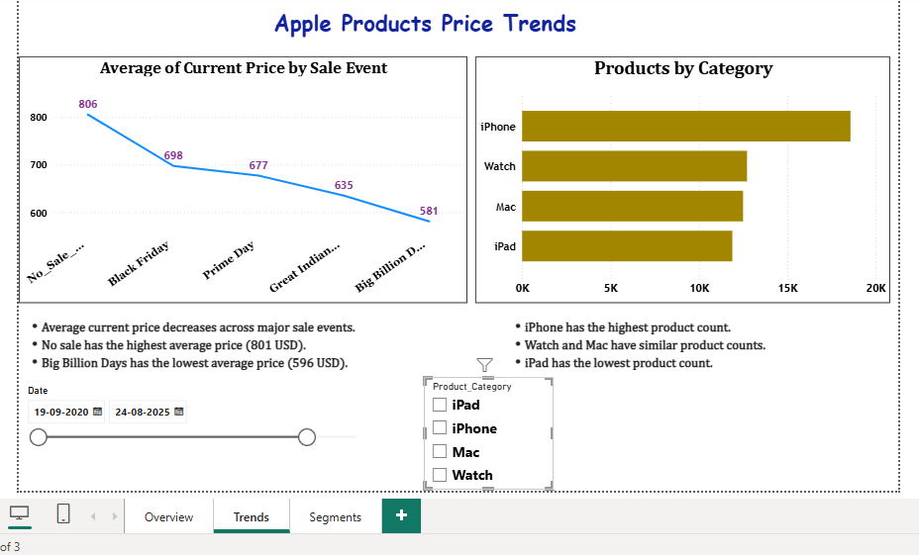
Power BI Dashboard
Dashboard Features
KPI cards
Interactive Slicers
Trend Analysis
Category & Stock Status
Drill-down Analysis
Dashboard Outcome
Interactive dashboards provide clear insights into pricing trends, product segments, and stock status

Slide 9
Project Outcomes & Key Insights
Key Outcomes
Analyzed e-commerce product pricing data from 2020–2026.
Identified pricing trends across different product categories and platforms.
Analyzed discounts, sale events, stock status, ratings, and customer reviews.
Built an interactive Power BI dashboard for business analysis.
Used Python, SQL, Excel, and Power BI for data analysis and visualization.
Key Insights
Product prices vary significantly across categories and platforms.
Discounts and sale events influence current product prices.
Stock availability differs across product categories.
Customer ratings help identify better-performing product categories.
Interactive dashboards make pricing and product analysis easier for decision-making.

Slide 10
Conclusion
Successfully completed an end-to-end analysis of e-commerce product pricing data.
Used Python, SQL, Excel, and Power BI for data cleaning, analysis, and visualization.
Identified important patterns in pricing, discounts, product categories, stock status, and ratings.
Developed an interactive Power BI dashboard to present insights clearly.
The project helped demonstrate how data analytics can support better pricing and business decisions.

Slide 11
Business Recommendations
Optimize Pricing: Adjust product prices based on market trends and sale events.
Monitor Discounts: Analyze discount levels to maintain competitive pricing while protecting margins.
Manage Inventory: Use stock-status insights to identify products requiring better inventory planning.
Focus on Product Categories: Identify high-performing categories and prioritize them for business growth.
Use Customer Feedback: Consider ratings and reviews when evaluating product performance.
Data-Driven Decisions: Use dashboard insights for continuous monitoring and strategic pricing decisions.

Slide 12
Future Scope
Price Prediction: Build Machine Learning models to predict future product prices.
Price Elasticity: Analyze how changes in price affect customer demand.
Competitor Analysis: Compare product prices with competitors.
Demand Forecasting: Predict future demand using historical pricing and sales patterns.
Real-Time Analytics: Integrate real-time data for continuous price monitoring.
Advanced Dashboard: Add predictive analytics and automated business alerts to Power BI.

Slide 13
Challenges and Learnings
Challenges & Learnings
Challenges
Handling and cleaning a large e-commerce dataset.
Managing missing values and inconsistent data.
Working with SQL data import and queries.
Creating meaningful Power BI visuals and dashboard layouts.
Combining insights from Python, SQL, Excel, and Power BI.
Key Learnings
Improved data cleaning and preprocessing skills.
Learned to analyze data using SQL and Excel Pivot Tables.
Gained practical experience in Power BI dashboard development.
Improved ability to identify and communicate business insights.
Developed an end-to-end understanding of the data analytics workflow.

